Slide 1
Python Assignment
Prepared by
Shivakumar Ravichandran

Slide 2
Table of content
Moving Average Algorithm
Simple Moving Average (SMA)
Popular Trading Patterns
Exponential Moving Average(EMA)
Steps to calculate EMA
Bollinger Bands Algorithm
How To Calculate Bollinger Bands
How To Calculate Bollinger Bands Example

Slide 3
Moving Average Algorithm

Slide 4
Moving Average Algorithm
In statistics a moving average is an algorithm that calculates the unweighted mean of the last n samples.
Types:
Simple Moving Average (SMA)
Exponential Moving Average (EMA)

Slide 5
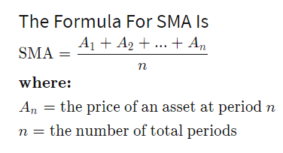
Simple Moving Average(SMA)
The SMA is a technical indicator for determining if an asset price will continue or reverse a bull or bear trend.
The SMA is calculated as the arithmetic average of an asset's price over some period.
The SMA can be enhanced as an exponential moving average (EMA) that more heavily weights recent price action.

Slide 6
Popular Trading Patterns
Death Cross
A short-term moving average breaks below a long-term moving average
Golden Cross
A short-term moving average breaks above a long-term moving average
Where
Short-term moving average: 50 days
Long-term moving average: 200 days

Slide 7
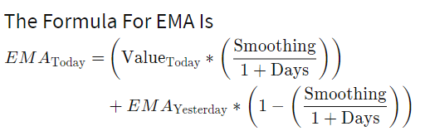
Exponential Moving Average(EMA)
The EMA is a moving average that places a greater weight and significance on the most recent data points.
Like all moving averages, this technical indicator is used to produce buy and sell signals based on crossovers and divergences from the historical average.
Traders often use several different EMA days, for instance, 20-day, 30-day, 90-day, and 200-day moving averages.

Slide 8
Steps to calculate EMA(1/2)
Find the Initial EMA Value
E.g., 14 + 13 + 14 + 12 + 13 = 66; 66 ÷ 5 = 13.2
So the SMA, which becomes your initial EMA value, is 13.2.
Calculate the Weighting Multiplier (Smoothing Constant)
2 ÷ (number of time periods + 1)
2 ÷ (5 + 1) = 2 ÷ 6 = 0.3333
Input That Information in the EMA Formula
EMA = (closing price - previous day's EMA) × smoothing constant as a decimal + previous day's EMA
EMA = (12 - 13.2) × 0.3333 + 13.2
EMA = 12.80
So the EMA value for day six is 12.80.

Slide 9
Steps to calculate EMA(2/2)
If the closing value on day seven was $11, you'd repeat the process, using day six's value of 12.80 as the new "previous day's EMA." So the calculation for day seven is as follows:
EMA = (11 - 12.8) × 0.3333 + 12.8
EMA = 12.20

Slide 10
Bollinger Bands Algorithm

Slide 11
Bollinger Bands Algorithm
A Bollinger Band® is a technical analysis tool defined by a set of lines plotted two standard deviations (positively and negatively) away from a SMA of the security's price, but can be adjusted to user preferences.
There are three lines that compose Bollinger Bands: A simple moving average (middle band) and an upper and lower band.
The upper and lower bands are typically 2 standard deviations +/- from a 20-day simple moving average, but can be modified.

Slide 12
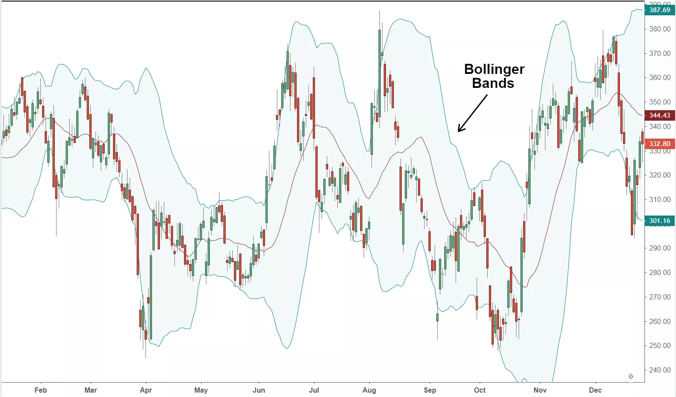
Bollinger Bands

Slide 13
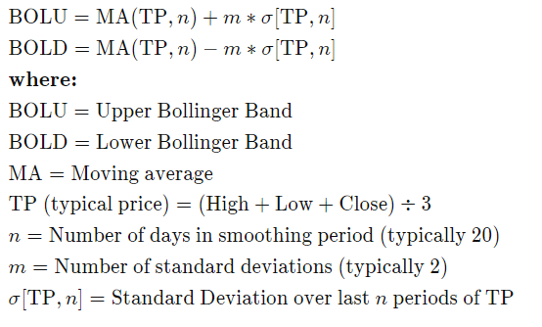
How To Calculate Bollinger Bands

Slide 14
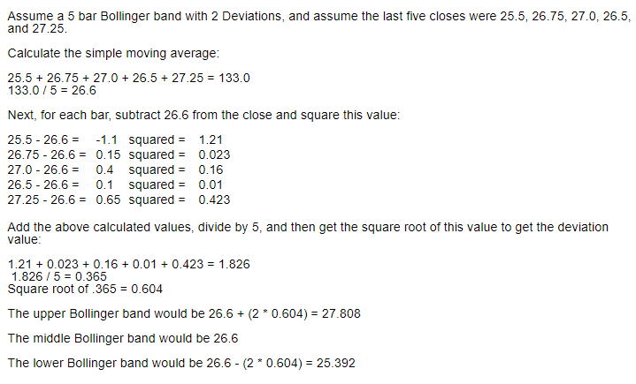
How To Calculate Bollinger Bands Example

Slide 15
Demo

Slide 16
Reference
https://www.investopedia.com/terms/s/sma.asp
https://www.investopedia.com/terms/e/ema.asp
https://sciencing.com/calculate-moving-range-4963173.html
https://www.investopedia.com/ask/answers/122314/what-exponential-moving-average-ema-formula-and-how-ema-calculated.asp
https://www.investopedia.com/terms/b/bollingerbands.asp
http://www.great-trades.com/Help/bollinger%20bands%20calculation.htm

